Slide 1
Welcome

Slide 2
Basic Networking

Slide 3
Internet?

Slide 4
HTML 5

Slide 5
What is HTML5 ?
it’s a buzzword refers to modern web technologies
it’s the core markup language of WWW, Developed at WHATWG
Primarily designed for semantically describing scientific documents

Slide 6
History of HTML5 ?
1. From roots to reform
1990–1995: HTML starts at CERN, then moves to the IETF. A period of rapid updates and experimentation.
1995: HTML 3.0 aimed big but fizzled.
📌 Solution? A more practical HTML 3.2 in 1997, followed closely by HTML4.
1998: W3C shifts focus to XHTML—an XML version of HTML.
2000: Launch of XHTML 1.0—HTML4 in XML clothes, no new features.
The focus shifts to XHTML Modularization—breaking it into reusable parts.
Meanwhile, XHTML2 was born—a clean slate, but not backward-compatible.
DOM APIs for HTML were also standardized around this time:
DOM Level 1 (1998)
DOM Level 2 (2000–2003)
DOM Level 3 started but left incomplete.
2003: XForms (future of web forms?) drops—sparks realization: ➤ XML didn’t replace HTML… but rather coexisted with new formats like RSS and Atom.

Slide 7
Developers prove that HTML4 could be extended to include many XForms features without breaking the web.
Opera takes the lead—publishes a draft under its copyright.
2004: Opera & Mozilla present their ideas at a W3C workshop. Rejected. W3C sticks to the XML path.
So... Apple, Mozilla, and Opera form WHATWG and continue independently.
🔓 Open spec, public mailing list, shared copyright.
WHATWG core values:
Backward compatibility
Spec matches real-world behavior
Detailed enough to avoid browser guesswork
HTML5 draft grows—combines HTML4, XHTML1, and DOM2 HTML into one powerful spec.
2006: W3C shows interest again.
2007: W3C and WHATWG start collaborating on HTML5.
2011: Differences resurface:
W3C wants a finished snapshot 📘
WHATWG prefers a Living Standard 🔄
2019: ✨ Happy ending—WHATWG and W3C agree to work together on a single, unified HTML standard.

Slide 10
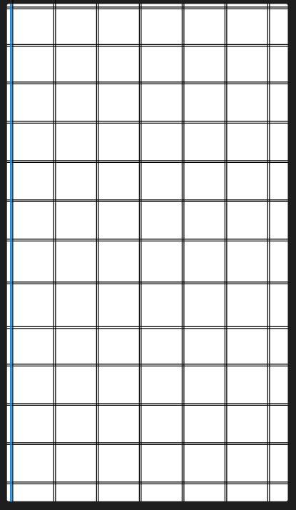
Flow lines
Vertical lines
Module

